Slide 1
Machine-Level Programming
60080013: Computer Organization
3rd Lecture, 2022
Instructors:
Sun Heng

Slide 2
Intel x86 Evolution: Milestones
Name Date Transistors
8086 1978 29K
  First 16-bit processor
  Basis for IBM PC & DOS
386 1985 275K
  First 32 bit processor , referred to as IA32
  Added “flat addressing”
  Capable of running Unix
Pentium 4E 2004 125M
  First 64-bit processor, referred to as x86-64
Core i7 2008 781M
  Multi-core machines
Core i7-10th 2019 15B
  Servers or mobile machines

Slide 3
x86 Clones: Advanced Micro Devices (AMD)
  AMD has followed just behind Intel
  A little bit slower, a lot cheaper

Slide 4
Machine Code Definitions
Architecture: (also ISA: instruction set architecture) The parts of a processor design that one needs to understand to write assembly code.
  Example ISAs (Intel): IA32, x86-64
Memory model: a very large byte array

Slide 5
Assembly Programmer’s View
CPU
Memory
Registers
Addresses
Data
Code
Data
Stack
PC
Condition
Codes
Instructions
Programmer-Visible State
  PC: Programcounter
    Address of next instruction
  Register file
    Heavily used program data
  Condition codes
    Store status information about most recent arithmetic operation
    Used for conditional branching
  Memory
    Byte addressable array
    Code and user data
    Stack to support procedures

Slide 6
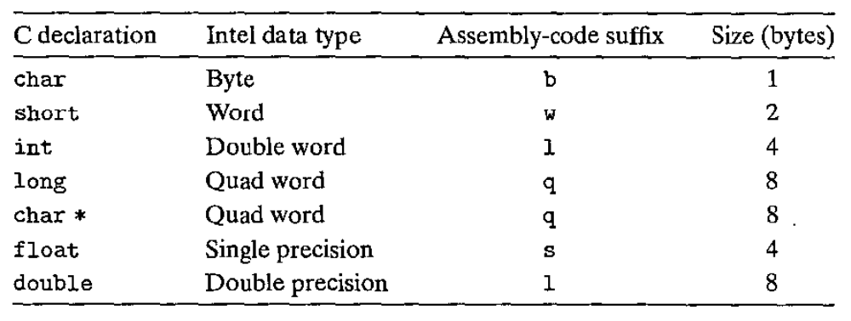
Assembly Characteristics: Data Types
Intel uses the term “word” to refer to a 16-bit data type. Based on this, they refer to 32-bit quantities as “double words.” They refer to 64-bit quantities as “quad words.”

Slide 7
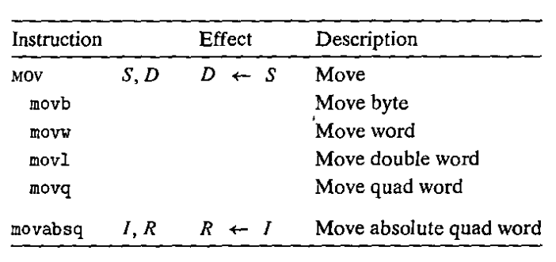
Assembly Characteristics: Instructions
The most heavily used instructions include data movement instructions-MOY class.
The class consists of four instructions: movb, movw, movl, and movq . All four of these instructions have similar effects; they differ primarily in that they operate on data of different sizes: 1, 2, 4, and 8 bytes, respectively.

Slide 8
x86-64 Integer Registers
%rax
%r8
%eax
%r8d
%rbx
%r9
%ebx
%r9d
%rcx
%r10
%ecx
%r10d
%rdx
%r11
%edx
%r11d
%rsi
%r12
%esi
%r12d
%rdi
%r13
%edi
%r13d
%rsp
%r14
%esp
%r14d
%rbp
%r15
%ebp
%r15d
  Can reference low-order 4 bytes (also low-order 1 & 2 bytes)

Slide 9
Some History: IA32 Registers
Origin
(mostly obsolete)
%eax
%ax
%ah
%al
accumulate
%ecx
%cx
%ch
%cl
counter
%edx
%dx
%dh
%dl
data
general purpose
%ebx
%bx
%bh
%bl
base
%esi
source
index
%si
%edi
destination
index
%di
%esp
stack
pointer
%sp
%ebp
base
pointer
%bp
16-bit virtual registers
(backwards compatibility)

Slide 10
Moving Data
%rax
%rcx
Moving Data
  movq Source, Dest
Operand Types
  Immediate: Constant integer data
    Example: $0x400, $-533
    Like C constant, but prefixed with ‘$’
    Encoded with 1, 2, 4 or 8 bytes
  Register: One of 16 integer registers
    Example: %rax, %r13
    But %rsp reserved for special use
    Others have special uses for particular instructions
  Memory: 8 consecutive bytes of memory at address given by register
    Simplest example: (%rax)
    Various other “addressing modes”
%rdx
%rbx
%rsi
%rdi
%rsp
%rbp
%rN
Warning: Intel docs use
mov Dest, Source

Slide 11
Simple Memory Addressing Modes
Normal (R) Mem[Reg[R]]
  Register R specifies memory address
  Aha! Pointer dereferencing in C
  movq (%rcx),%rax
Displacement D(R) Mem[Reg[R]+D]
  Register R specifies start of memory region
  Constant displacement D specifies offset
  movq 8(%rbp),%rdx

Slide 12
Complete Memory Addressing Modes
Most General Form
D(Rb,Ri,S) Mem[Reg[Rb]+S*Reg[Ri]+ D]
  D: Constant “displacement”
  Rb: Base register: Any of 16 integer registers
  Ri: Index register: Any, except for %rsp
  S: Scale: 1, 2, 4, or 8
Special Cases
(Rb,Ri) Mem[Reg[Rb]+Reg[Ri]]
D(Rb,Ri) Mem[Reg[Rb]+Reg[Ri]+D]
(Rb,Ri,S) Mem[Reg[Rb]+S*Reg[Ri]]

Slide 13
Address Computation Examples
Carnegie Mellon
%rdx | 0xf000
%rcx | 0x0100
Expression | Address Computation | Address
0x8(%rdx)
(%rdx,%rcx)
(%rdx,%rcx,4)
0x80(,%rdx,2)
Expression | Address Computation | Address
0x8(%rdx) | 0xf000 + 0x8 | 0xf008
(%rdx,%rcx) | 0xf000 + 0x100 | 0xf100
(%rdx,%rcx,4) | 0xf000 + 4*0x100 | 0xf400
0x80(,%rdx,2) | 2*0xf000 + 0x80 | 0x1e080

Slide 14
movq Operand Combinations
Source
Dest
Src,Dest
C Analog
Reg
movq $0x4,%rax
temp = 0x4;
Imm
Mem
movq $-147,(%rax)
*p = -147;
Reg
movq %rax,%rdx
temp2 = temp1;
movq
Reg
Mem
movq %rax,(%rdx)
*p = temp;
Mem
Reg
movq (%rax),%rdx
temp = *p;
Cannot do memory-memory transfer with a single instruction

Slide 15
Example of Simple Addressing Modes
void swap
(long *xp, long *yp)
{
long t0 = *xp;
long t1 = *yp;
*xp = t1;
*yp = t0;
}
swap:
movq (%rdi), %rax
movq (%rsi), %rdx
movq %rdx, (%rdi)
movq %rax, (%rsi)
ret

Slide 16
Understanding Swap()
Memory
void swap
(long *xp, long *yp)
{
long t0 = *xp;
long t1 = *yp;
*xp = t1;
*yp = t0;
}
Registers
%rdi
%rsi
%rax
%rdx
Register Value
%rdi xp
%rsi yp
%rax t0
%rdx t1
swap:
movq (%rdi), %rax # t0 = *xp
movq (%rsi), %rdx # t1 = *yp
movq %rdx, (%rdi) # *xp = t1
movq %rax, (%rsi) # *yp = t0
ret

Slide 17
Understanding Swap()
Memory
Registers
Address
123
0x120
%rdi
0x120
0x118
%rsi
0x100
0x110
%rax
0x108
%rdx
456
0x100
swap:
movq (%rdi), %rax # t0 = *xp
movq (%rsi), %rdx # t1 = *yp
movq %rdx, (%rdi) # *xp = t1
movq %rax, (%rsi) # *yp = t0
ret

Slide 18
Understanding Swap()
Memory
Registers
Address
123
0x120
%rdi
0x120
0x118
%rsi
0x100
0x110
%rax
123
0x108
%rdx
456
0x100
swap:
movq (%rdi), %rax # t0 = *xp
movq (%rsi), %rdx # t1 = *yp
movq %rdx, (%rdi) # *xp = t1
movq %rax, (%rsi) # *yp = t0
ret

Slide 19
Understanding Swap()
Memory
Registers
Address
123
0x120
%rdi
0x120
0x118
%rsi
0x100
0x110
%rax
123
0x108
%rdx
456
456
0x100
swap:
movq (%rdi), %rax # t0 = *xp
movq (%rsi), %rdx # t1 = *yp
movq %rdx, (%rdi) # *xp = t1
movq %rax, (%rsi) # *yp = t0
ret

Slide 20
Understanding Swap()
Memory
Registers
Address
456
0x120
%rdi
0x120
0x118
%rsi
0x100
0x110
%rax
123
0x108
%rdx
456
456
0x100
swap:
movq (%rdi), %rax # t0 = *xp
movq (%rsi), %rdx # t1 = *yp
movq %rdx, (%rdi) # *xp = t1
movq %rax, (%rsi) # *yp = t0
ret

Slide 21
Understanding Swap()
Memory
Registers
Address
456
0x120
%rdi
0x120
0x118
%rsi
0x100
0x110
%rax
123
0x108
%rdx
456
123
0x100
swap:
movq (%rdi), %rax # t0 = *xp
movq (%rsi), %rdx # t1 = *yp
movq %rdx, (%rdi) # *xp = t1
movq %rax, (%rsi) # *yp = t0
ret

Slide 22
Some Arithmetic Operations
Carnegie Mellon
Two Operand Instructions:
  Format Computation
    addq Src,Dest Dest = Dest + Src
    subq Src,Dest Dest = Dest − Src
    imulq Src,Dest Dest = Dest * Src
    salq Src,Dest Dest = Dest << Src Also called shlq
    sarq Src,Dest Dest = Dest >> Src Arithmetic
    shrq Src,Dest Dest = Dest >> Src Logical
    xorq Src,Dest Dest = Dest ^ Src
    andq Src,Dest Dest = Dest & Src
    orq Src,Dest Dest = Dest | Src
Watch out for argument order!

Slide 23
Some Arithmetic Operations
Carnegie Mellon
One Operand Instructions
    incq Dest Dest = Dest + 1
    decq Dest Dest = Dest − 1
    negq Dest Dest = − Dest
    notq Dest Dest = ~Dest
See book for more instructions

Slide 24
Processor State (x86-64, Partial)
Information about currently executing program
  Temporary data
  ( %rax, … )
  Location of runtime stack
  ( %rsp )
  Status of recent tests
  ( CF, ZF, SF, OF )
Registers
%rax
%r8
%rbx
%r9
%rcx
%r10
%rdx
%r11
Current stack top
%rsi
%r12
%rdi
%r13
%rsp
%r14
%rbp
%r15
CF
ZF
SF
OF
Condition codes

Slide 25
Condition Codes (Implicit Setting)
Single bit registers
  CF Carry Flag (for unsigned) SF Sign Flag (for signed)
  ZF Zero Flag OF Overflow Flag (for signed)
Implicitly set (as side effect) of arithmetic operations
  Example: addq Src,Dest ↔ t = a+b
  CF set if carry/borrow out from most significant bit (unsigned overflow)
  ZF set if t == 0
  SF set if t < 0 (as signed)
  OF set if two’s-complement (signed) overflow
  (a>0 && b>0 && t<0) || (a<0 && b<0 && t>=0)
Not set by leaq instruction

Slide 26
CF set when
1xxxxxxxxxxxx...
+
1xxxxxxxxxxxx...
Carry
1
xxxxxxxxxxxxx...
1
0xxxxxxxxxxxx...
-
1xxxxxxxxxxxx...
Borrow
1xxxxxxxxxxxx...
For unsigned arithmetic, this reports overflow

Slide 27
SF set when
yxxxxxxxxxxxx...
+
yxxxxxxxxxxxx...
1xxxxxxxxxxxx...
For signed arithmetic, this reports when result is a negative number

Slide 28
OF set when
yxxxxxxxxxxxx...
+
yxxxxxxxxxxxx...
zxxxxxxxxxxxx...
z = ~y
For signed arithmetic, this reports overflow

Slide 29
ZF set when
000000000000…00000000000

Slide 30
Condition Codes (Explicit Setting: Compare)
Explicit Setting by Compare Instruction
  cmpq Src2, Src1
  cmpq b,a like computing a-b without setting destination
  CF set if carry/borrow out from most significant bit
  (used for unsigned comparisons)
  ZF set if a == b
  SF set if (a-b) < 0 (as signed)
  OF set if two’s-complement (signed) overflow
  (a>0 && b<0 && (a-b)<0) || (a<0 && b>0 && (a-b)>0)

Slide 31
Condition Codes (Explicit Setting: Test)
Explicit Setting by Test instruction
  testq Src2, Src1
    testq b,a like computing a&b without setting destination
  Sets condition codes based on value of Src1 & Src2
  Useful to have one of the operands be a mask
  ZF set when a&b == 0
  SF set when a&b < 0
Very often:
testq %rax,%rax

Slide 32
Reading Condition Codes
SetX Instructions
  Set low-order byte of destination to 0 or 1 based on combinations of condition codes
  Does not alter remaining 7 bytes
SetX | Condition | Description
sete | ZF | Equal / Zero
setne | ~ZF | Not Equal / Not Zero
sets | SF | Negative
setns | ~SF | Nonnegative
setg | ~(SF^OF)&~ZF | Greater (Signed)
setge | ~(SF^OF) | Greater or Equal (Signed)
setl | (SF^OF) | Less (Signed)
setle | (SF^OF)|ZF | Less or Equal (Signed)
seta | ~CF&~ZF | Above (unsigned)
setb | CF | Below (unsigned)

Slide 33
x86-64 Integer Registers
%rax
%r8
%al
%r8b
%rbx
%r9
%bl
%r9b
%rcx
%r10
%cl
%r10b
%rdx
%r11
%dl
%r11b
%rsi
%r12
%sil
%r12b
%rdi
%r13
%dil
%r13b
%rsp
%r14
%spl
%r14b
%rbp
%r15
%bpl
%r15b
  Can reference low-order byte

Slide 34
Reading Condition Codes (Cont.)
SetX Instructions:
  Set single byte based on combination of condition codes
One of addressable byte registers
  Does not alter remaining bytes
  Typically use movzbl to finish job
    movzbl instruction also set upper bits to 0
Register | Use(s)
%rdi | Argument x
%rsi | Argument y
%rax | Return value
int gt (long x, long y)
{
return x > y;
}
cmpq %rsi, %rdi # Compare x:y
  setg %al # Set when >
  movzbl %al, %eax # Zero rest of %rax
ret

Slide 35
Reading Condition Codes (Cont.)
SetX Instructions:
  Set single byte based on combination of condition codes
One of addressable byte registers
  Does not alter remaining bytes
  Typically use movzbl to finish job
    32-bit instructions also set upper 32 bits to 0
Beware weirdness movzbl (and others)
movzbl %al, %eax
0x00000000
%rax
%rax
%al
0x000000
%al
0x000000
%al
%eax
Register | Use(s)
%rdi | Argument x
%rsi | Argument y
%rax | Return value
int gt (long x, long y)
{
return x > y;
}
Zapped to all 0’s
cmpq %rsi, %rdi # Compare x:y
  setg %al # Set when >
  movzbl %al, %eax # Zero rest of %rax
ret

Slide 36

Jumping
Carnegie Mellon
  assembly code
  indirect jump
    jmp *%rax
    Jmp *(%rax)

Slide 37
Jumping
Carnegie Mellon
jX Instructions
  Jump to different part of code depending on condition codes
jX | Condition | Description
jmp | 1 | Unconditional
je | ZF | Equal / Zero
jne | ~ZF | Not Equal / Not Zero
js | SF | Negative
jns | ~SF | Nonnegative
jg | ~(SF^OF)&~ZF | Greater (Signed)
jge | ~(SF^OF) | Greater or Equal (Signed)
jl | (SF^OF) | Less (Signed)
jle | (SF^OF)|ZF | Less or Equal (Signed)
ja | ~CF&~ZF | Above (unsigned)
jb | CF | Below (unsigned)

Slide 38
Conditional Branch Example (Old Style)
Generation
  shark> gcc –Og -S –fno-if-conversion control.c
absdiff:
cmpq %rsi, %rdi # x:y
jle .L4
movq %rdi, %rax
subq %rsi, %rax
ret
.L4: # x <= y
movq %rsi, %rax
subq %rdi, %rax
ret
long absdiff
(long x, long y)
{
long result;
if (x > y)
result = x-y;
else
result = y-x;
return result;
}
Register | Use(s)
%rdi | Argument x
%rsi | Argument y
%rax | Return value

Slide 39
Expressing with Goto Code
C allows goto statement
Jump to position designated by label
long absdiff
(long x, long y)
{
long result;
if (x > y)
result = x-y;
else
result = y-x;
return result;
}
long absdiff_j
(long x, long y)
{
long result;
int ntest = x <= y;
if (ntest) goto Else;
result = x-y;
goto Done;
Else:
result = y-x;
Done:
return result;
}

Slide 40
General “Do-While” Translation
C Code
Goto Version
do
Body
while (Test);
loop:
Body
if (Test)
goto loop
Body:
{
Statement₁;
Statement₂;
…
Statement_{n};
}

Slide 41
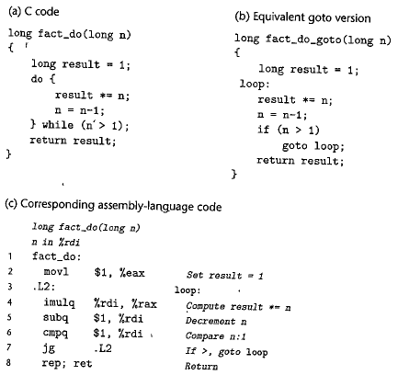
Carnegie Mellon
“Do-While” Loop Example

Slide 42
General “While” Translation
Carnegie Mellon
While version
while (Test)
Body
Do-While Version
if (!Test)
goto done;
do
Body
while(Test);
done:

Slide 43
“For” Loop → While Loop
Carnegie Mellon
For Version
for (Init; Test; Update )
Body
While Version
Init;
while (Test ) {
Body
Update;
}

Slide 44
Procedures
Carnegie Mellon
A procedure call involves passing both data (in the form of procedure parameters and return values) and control from one part of a program to another. In addition, it must allocate space for the local variables of the procedure on entry and deallocate them on exit. Most machines, including X86-64, provide only simple instructions for transferring control to and from procedures. The passing of data and the allocation and deallocation of local variables is handled by manipulating the program stack.

Slide 45
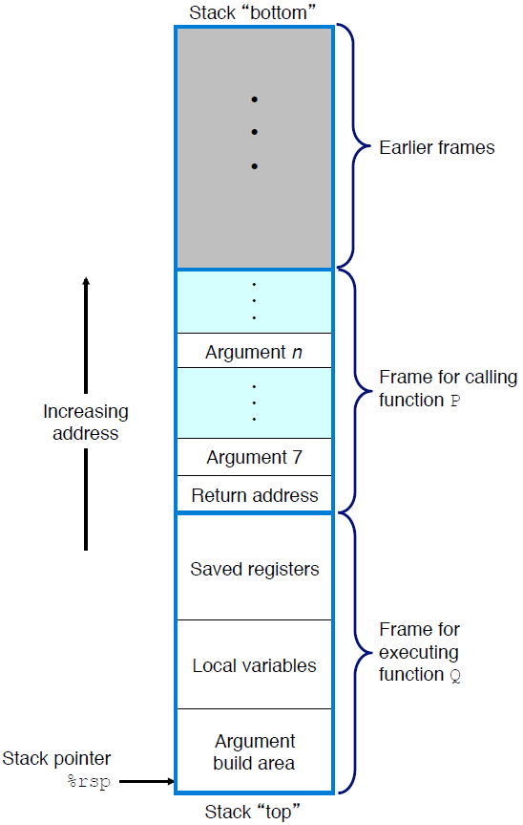

Stack Frame Structure
Carnegie Mellon

Slide 46

Transferring Control
Carnegie Mellon

Slide 47
Register Saving Conventions
When procedure yoo calls who:
  yoo is the caller
  who is the callee
Can a register be used for temporary storage?
  Contents of register %rdx overwritten by who
  If a callee clobbers your register, its value is lost!
    Need coordination between caller/callee
yoo:
• • •
movq $15213, %rdx
call who
addq %rdx, %rax
• • •
ret
who:
• • •
subq $18213, %rdx
• • •
ret

Slide 48
Register Saving Conventions
When procedure yoo calls who:
  yoo is the caller
  who is the callee
Can register be used for temporary storage?
Conventions
  “Caller Saved”
    Caller must save values in its stack frame before call
  “Callee Saved”
    Callee saves values in its frame before using
    Callee restores values before returning

Slide 49
x86-64 Linux Register Usage #1
%rax
  Return value
  Also caller-saved
  Can be modified by procedure
%rdi, ..., %r9
  Integer arguments
  Also caller-saved
  Can be modified by procedure
%r10, %r11
  Caller-saved
  Can be modified by procedure
Caller-saved
Return value
%rax
%rdi
%rsi
%rdx
Caller-saved
Arguments
%rcx
%r8
%r9
%r10
Caller-saved
Temporaries
%r11

Slide 50
x86-64 Linux Register Usage #2
%rbx, %r12, %r13, %r14
,%r15
  Callee-saved
  Callee must save & restore
%rbp
  Callee-saved
  Callee must save & restore
  May be used as frame pointer
  Compiler decides use of rbp
%rsp
  Special form of callee save
  Restored to original value upon exit from procedure
%rbx
%r12
Callee-saved
Temporaries
%r13
%r14
%r15
%rbp
Special
%rsp

Slide 51
Array Allocation
Arrays in C are one means of aggregating scalar data into larger data types. C uses a particularly simple implementation of arrays, and hence the translation into machine code is fairly straightforward. One unusual feature of C is that we can generate pointers to elements within arrays and perform arithmetic with these pointers. These are translated into address computations in machine code.

Slide 52

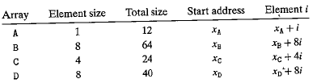
Array Allocation
Basic Principle
  T A[N];
  Array of data type T and length N
  Contiguously allocated region of L * N bytes, where L = sizeof(T)
consider the following declarations:

Slide 53
Pointer Arithmetic
C allows arithmetic on pointers, where the computed value is scaled according to the size of the data type referenced by the pointer. That is, if p is a pointer to data of type T , and the value of p is xp, then the expression p+i has value xp+ L*i, where L is the size of data type T .

Slide 54
Array Allocation
The unary operators & and * allow the generation and dereferencing of pointers. That is, for an expression Expr denoting some object, &Expr is a pointer giving the address of the object. For an expression AExpr denoting an address, *AExpr gives the value at that address. The expressions Expr and *&Expr are therefore equivalent. The array subscripting operation can be applied to both arrays and pointers. The array reference A[i] is identical to the expression *(A+i). It computes the address of the ith array element and then accesses this memory location.

Slide 55
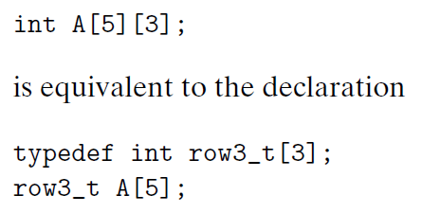
Nested Arrays
The general principles of array allocation and referencing hold even when we create arrays of arrays.

Slide 56
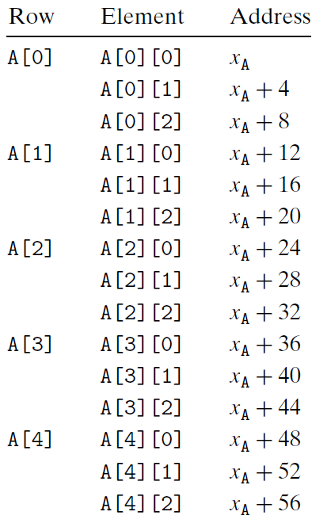
Nested Arrays
consequence of the nested declaration

Slide 57
Structures & Alignment
Unaligned Data
Aligned Data
  Primitive data type requires K bytes
  Address must be multiple of K
struct S1 {
char c;
int i[2];
double v;
} *p;
c
i[0]
i[1]
v
p
p+1
p+5
p+9
p+17
c
3 bytes
i[0]
i[1]
4 bytes
v
p+0
p+4
p+8
p+16
p+24
Multiple of 4
Multiple of 8
Multiple of 8
Multiple of 8

Slide 58
Alignment Principles
Aligned Data
  Primitive data type requires K bytes
  Address must be multiple of K
  Required on some machines; advised on x86-64
Motivation for Aligning Data
  Memory accessed by (aligned) chunks of 4 or 8 bytes (system dependent)
Compiler
  Inserts gaps in structure to ensure correct alignment of fields

Slide 59
Specific Cases of Alignment (x86-64)
1 byte: char, …
2 bytes: short, …
4 bytes: int, float, …
8 bytes: double, long, char *, …

Slide 60
Classwork
Problem 3.8 & 3.45

Slide 61
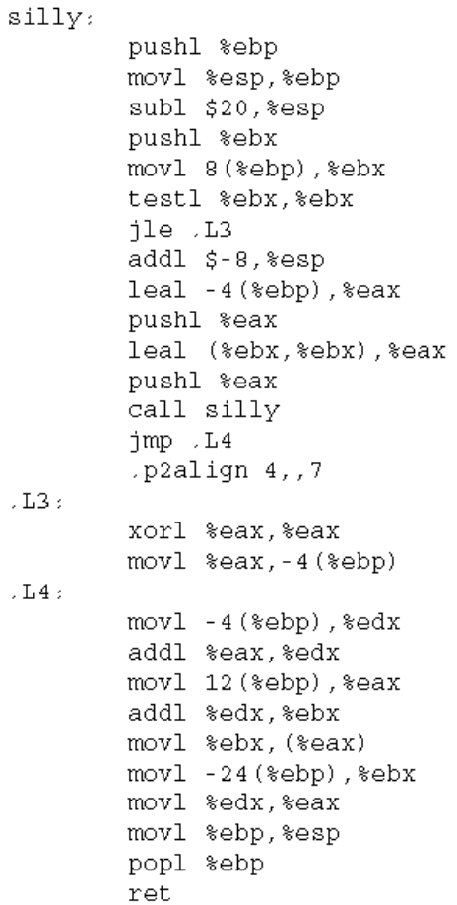
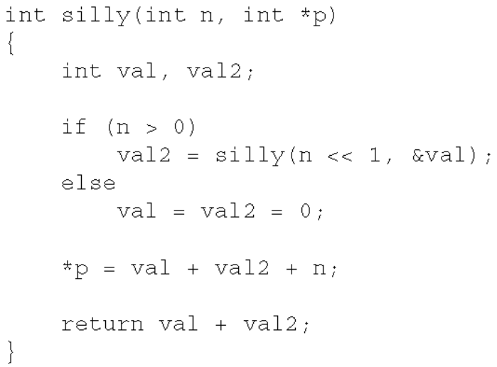
Classwork
This problem will test your understanding of stack frames. It is based on the following recursive C function
(Fig.1), and yields the machine code as Fig. 2.
Fig.1 Fig. 2
Question 1. Is the variable val stored on the stack? If so, at what byte offset (relative to %ebp) is it stored, and why is it necessary to
store it on the stack?
Question 2. Is the variable val2 stored on the stack? If so, at what byte offset (relative to %ebp) is it stored, and why is it necessary to
store it on the stack?
Question 3. What (if anything) is stored at -24(%ebp)? If something is stored there, why is it necessary to store it?
Question 4. What (if anything) is stored at -8(%ebp)? If something is stored there, why is it necessary to store it?

